Slide 1
BCT 2305-Data Communication
Analog and Digital Modulation

Slide 2
Overview
Communication systems
Analog Modulation
  AM
  FM
Digital Modulation
  ASK
  FSK
Modems

Slide 3
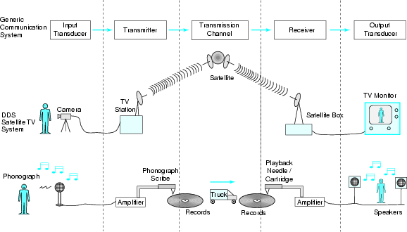
Communication systems
Digital
Analog
The block diagram on the top shows the blocks common to all communication systems

Slide 4
Remember the components of a communications system:
Input transducer: The device that converts a physical signal from source to an electrical, mechanical or electromagnetic signal more suitable for communicating
Transmitter: The device that sends the transduced signal
Transmission channel: The physical medium on which the signal is carried
Receiver: The device that recovers the transmitted signal from the channel
Output transducer: The device that converts the received signal back into a useful quantity

Slide 5
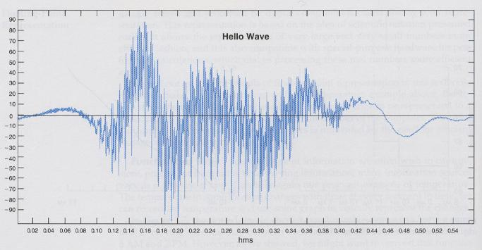
Analog Modulation
The purpose of a communication system is to transmit information signals (baseband signals) through a communication channel
The term baseband is used to designate the band of frequencies representing the original signal as delivered by the input transducer
  For example, the voice signal from a microphone is a baseband signal, and contains frequencies in the range of 0-3000 Hz
  The “hello” wave is a baseband signal:

Slide 6
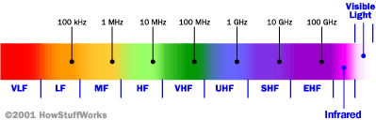
Since this baseband signal must be transmitted through a communication channel such as air using electromagnetic waves, an appropriate procedure is needed to shift the range of baseband frequencies to other frequency ranges suitable for transmission, and a corresponding shift back to the original frequency range after reception. This is called the process of modulation and demodulation
Remember the radio spectrum:
For example, an AM radio system transmits electromagnetic waves with frequencies of around a few hundred kHz (MF band)
The FM radio system must operate with frequencies in the range of 88-108 MHz (VHF band)
AM radio
FM radio/TV

Slide 7
Since the baseband signal contains frequencies in the audio frequency range (3 kHz), some form of frequency-band shifting must be employed for the radio system to operate satisfactorily
This process is accomplished by a device called a modulator
The transmitter block in any communications system contains the modulator device
The receiver block in any communications system contains the demodulator device
The modulator modulates a carrier wave (the electromagnetic wave) which has a frequency that is selected from an appropriate band in the radio spectrum
  For example, the frequency of a carrier wave for FM can be chosen from the VHF band of the radio spectrum
  For AM, the frequency of the carrier wave may be chosen to be around a few hundred kHz (from the MF band of the radio spectrum)
The demodulator extracts the original baseband signal from the received modulated signal
  To Summarize:
Modulation is the process of impressing a low-frequency information signal (baseband signal )onto a higher frequency carrier signal
Modulation is done to bring information signals up to the Radio Frequency (or higher) signal

Slide 8


Basic analog communications system
Baseband signal (electrical signal)
EM waves (modulated signal)
Transmitter
Input transducer
Transmission Channel
Modulator
Carrier
EM waves (modulated signal)
Baseband signal (electrical signal)
Receiver
Output transducer
Demodulator

Slide 9
Types of Analog Modulation
Amplitude Modulation (AM)
  Amplitude modulation is the process of varying the amplitude of a carrier wave in proportion to the amplitude of a baseband signal. The frequency of the carrier remains constant
Frequency Modulation (FM)
  Frequency modulation is the process of varying the frequency of a carrier wave in proportion to the amplitude of a baseband signal. The amplitude of the carrier remains constant
Phase Modulation (PM)
  Another form of analog modulation technique which we will not discuss

Slide 10
Amplitude Modulation
Carrier wave
Baseband signal
Modulated wave
Amplitude varying-frequency constant

Slide 11
Frequency Modulation
Carrier wave
Baseband signal
Small amplitude: low frequency
Large amplitude: high frequency
Modulated wave
Frequency varying-amplitude constant

Slide 12
AM vs. FM
AM requires a simple circuit, and is very easy to generate.
It is simple to tune, and is used in almost all short wave broadcasting.
The area of coverage of AM is greater than FM (longer wavelengths (lower frequencies) are utilized-remember property of HF waves?)
However, it is quite inefficient, and is susceptible to static and other forms of electrical noise.
The main advantage of FM is its audio quality and immunity to noise. Most forms of static and electrical noise are naturally AM, and an FM receiver will not respond to AM signals.
The audio quality of a FM signal increases as the frequency deviation increases (deviation from the center frequency), which is why FM broadcast stations use such large deviation.
The main disadvantage of FM is the larger bandwidth it requires

Slide 13
Digital Modulation
The previous section presented analog communication systems that transmit information in analog form using Amplitude or Frequency modulation
Digital communication systems also employ modulation techniques, some of which include:
  Amplitude Shift Keying
  Frequency Shift Keying
  Phase Shift Keying

Slide 14
Basic digital communications system
Transmitter
EM waves (modulated signal)
Analog signal
Digital signal
Error correction coding
Input transducer
A/D converter
Transmission Channel
Modulator
Carrier
EM waves (modulated signal)
Receiver
analog signal
digital signal
Error detection/ correction
Output transducer
D/A converter
Demodulator

Slide 15
Some Types of Digital Modulation
Amplitude Shift Keying (ASK)
  The most basic (binary) form of ASK involves the process of switching the carrier either on or off, in correspondence to a sequence of digital pulses that constitute the information signal. One binary digit is represented by the presence of a carrier, the other binary digit is represented by the absence of a carrier. Frequency remains fixed
Frequency Shift Keying (FSK)
  The most basic (binary) form of FSK involves the process of varying the frequency of a carrier wave by choosing one of two frequencies (binary FSK) in correspondence to a sequence of digital pulses that constitute the information signal. Two binary digits are represented by two frequencies around the carrier frequency. Amplitude remains fixed
Phase Shift Keying (PSK)
  Another form of digital modulation technique which we will not discuss

Slide 16

Amplitude Shift Keying
1 0 1 1 0 0 1 0 1 0
Digital information
Carrier wave
ASK modulated signal
Amplitude varying-frequency constant
Carrier present
Carrier absent

Slide 17
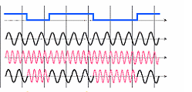
Frequency Shift Keying
1 0 1 1 0 0 1
Digital information
Carrier 1 (frequency #1)
Carrier 2 (frequency #2)
FSK modulated signal
Frequency varying-amplitude constant

Slide 18
Modems
Modems are devices used to enable the transfer of data over the public switched telephone network (PSTN)
The name modem comes from the name MOulator- DEModulator which describes the function the modem performs to transfer digital information over an analog network
The goal is to produce a signal that can be transmitted easily and decoded to reproduce the original digital data. Primarily used to communicate via telephone lines, modems can be used over any means of transmitting analog signals
There are many kinds of modems available today:
  Internal modem:
    A modem card in your computer that is integrated within the system
    Less expensive than external modems
    Disadvantage is that you need to access inside the computer to replace the modem
  External modem
    A device that connects externally to your computer through a serial port
    External power supply does not drain power from the computer
    Modem activity can easily be observed
    More expensive than an internal modem
Source: http://Wikipedia.com

